Slide 1
The HB123 Approach
Sources of Strength Ohio Training Module
Notes:
Speaker’s notes:
The SAVE (Safety and Violence Education) Students Act, also known as House Bill 123 (HB123), was passed by the Ohio General Assembly in late 2020. The goal of the legislation is to increase students’ emotional and physical safety by integrating evidence-based safety training and programming into schools. This includes suicide prevention, violence prevention, and social inclusion, as well as threat assessment teams and training, anonymous reporting systems, and emergency management plans. We’re going to focus on the suicide prevention components, but just know there are additional requirements beyond the scope of today’s presentation that help schools develop a comprehensive approach to student safety.
This school has chosen Sources of Strength to meet the requirements of HB123, also know as the SAVE Students Act. Before we close today, we’re going to talk about what this legislation is and how you all can implement Sources to ensure your school is compliant with its standards.

Slide 2
HB123 Key Requirements
Approved program
Grades 6-12
1 hour
Notes:
Speaker’s notes:
Here are the components most important for Sources teams to consider as you implement the Secondary Program in your school:
Schools must implement a program that has been approved by the Ohio Department of Education.
Programming must include at least one hour or standard class period of instruction.
Programming must reach all students in grades 6-12
As you might have guessed, Sources of Strength is one of those approved programs, but maintaining compliance with the legislation isn’t as simple as implementing Sources. We’ll get into more of those details in a few slides.

Slide 3
Approved Programs “Musts”
Must be evidence-based
Must cover specific content
Notes:
Speaker’s notes:
Programs must be evidence-based to qualify for the Department of Education’s list of approved programs,
And they must cover specific content such as suicide risk factors and warning signs.
We’ll go over each of the content requirements next, but you can refer to your SAVE Students Act handout (Handout 1) in your Adult Advisor packet if you’d like to review those content requirements now.

Slide 4
HB123 Content Requirements
Review plans for bi-annual staff suicide prevention training
Consider options for sharing with the rest of the staff
How to instruct school personnel to identify the signs and symptoms of depression, suicide, and self-harm in students.
Notes:
Speaker’s notes:
The first content requirement for approved programs is that they instruct school personnel on how to identify the signs and symptoms of depression, suicide, and self-harm in students. There’s a bit of overlap here with another section of the Ohio Revised Code that requires school personnel to engage in a bi-annual staff suicide prevention training. It’s important to note that your school may already be utilizing a training that fulfills this part of HB123.
Discussion questions:
Does your school have a training in place to satisfy the bi-annual suicide prevention training?
Does that training cover the content listed on this slide?
Has the school already conducted a training on this content this year?
If participants answer “yes” to all of the questions above, let the participants know they can still utilize Sources to complement existing training (see below). If participants answer “no” to any of the questions above, recommend the Risk Factors and Warning Signs module with staff. This module models how to instruct individuals on how to identify the signs and symptoms of depression, suicide, and self-harm in students.
As a group, brainstorm options to bring this information to school personnel, such as having the Adult Advisors facilitate the Risk Factors and Warning Signs module during a staff meeting or Professional Development day.
Remind participants that the Risk Factors and Warning Signs module with staff (Handout 2) and Peer Leader Mission Statement (Handout 3) are included in their Adult Advisor Packet.

Slide 5
HB123 Content Requirements
Suicide intervention protocol
Local mental health services available?
School counselor?
How to identify appropriate mental health services within schools and larger communities and when and how to refer youth and their families to those services.
Contracted mental health clinician?
Crisis text line?
Notes:
Speaker’s notes:
The second content requirement is, “How to identify appropriate mental health services within schools and larger communities and when and how to refer youth and their families to those services.”
During your pre training call between the school and yourself (the local trainer), you’ll want to ask about the school’s suicide intervention protocol. Guidance on this topic can be found both in the Adult Advisor manual on page 98- Significant Events and Protocol Review, as well as in the Adult Advisor Training packet for HB123 (found on the Sources OH website) in Handout 4.
If a school does not have a comprehensive Suicide Intervention Protocol, you can refer to Handout 5 in the Adult Advisor Training packet for HB123 (again found on the Sources OH website)

Slide 6
HB123 Content Requirements
How to identify the signs and symptoms of depression, suicide and self-harm in their peers;
How to teach students about mental health and depression, warning signs of suicide and the importance of and processes for seeking help on behalf of self and peers and reporting of these behaviors;
How to identify observable warning signs and signals of individuals who may be a threat to themselves or others;
The importance of taking threats seriously and seeking help .
Getting the Word Out
Connecting to Help
Trusted Adults
What Helps Me
Notes:
Speaker’s notes:
HB123’s remaining content-related requirements are covered by four of Sources of Strength’s templated campaigns.
Read off the content requirements one by one and ask the participants to pull out their blank Sources Campaign Planning Template (Handout 6) from their Adult Advisor Training Packets.
Explain that their packets include Planning Templates (Handouts 8, 10, 12, and 14) for each of the campaigns on this slide, and that Sources teams can easily use these campaigns to cover this content within the legislation’s one-hour requirement.
Remind participants that their Sources teams can create their own campaigns to fulfill HB123 as well, or in addition to the four campaigns on the slide – which is why they have a blank template in addition to specific templates.

Slide 7
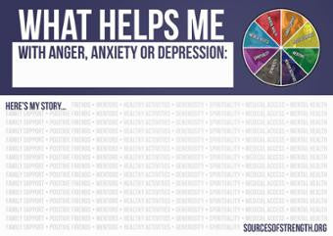
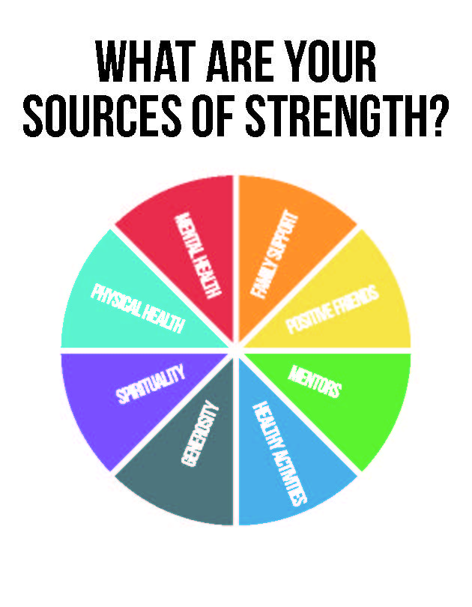
Implementing Sources to Satisfy HB123: Content Requirements
Connecting to Help
Trusted Adults
What Helps Me
Getting the Word Out
Notes:
Speaker’s notes:
In addition to the Campaign Planning Templates, Sources offers guidance on how to implement these campaigns on their website and in the Adult Advisor Field Guide (starting on p. 55).
Comprehensive guides on each of these four campaigns (Handouts 7, 9, 11, and 13) can be found in your Adult Advisor Packet. Review these before the Peer Leader Training for inspiration on the different activities that can be implemented as part of each campaign.
You can also visit the Sources of Strength website to see pictures and videos of what other Sources teams have done these campaigns.

Slide 8
HB123 Key Requirements
Approved program
Grades 6-12
1 hour
Notes:
Speaker’s notes:
Now that we’ve covered the content requirements of the approved program, we’re going to jump back to the other requirements.
As mentioned earlier, the SAVE Students Act requires the approved program to engage all students in grades 6-12 for one-hour or standard classroom period. That one hour can be split up over the course of several class periods, and your standard classroom period can run a little bit shorter or a little bit longer than one hour depending on your individual school’s class schedule.

Slide 9
Implementing Sources to Satisfy HB123: One Hour of Instruction
Classroom integration
Peer Leader presentations
All school activities
Home room/advisory period
Notes:
Speaker’s notes:
The Planning Templates in your Adult Advisor packets have been designed to help your Sources teams plan campaigns that reach every student for at least one hour per year. This can help your Sources team make sure that your activities make an impact on the entire student body.
There are various ways that campaigns can take shape. To reach every student for at least one hour or standard class period, we would encourage Sources teams to focus on all school activities and classroom activities to reach compliance with the legislation.

Slide 10
FIDELITY MARKERS (CHECKLIST)
SAVE Students Act
Our Adult Advisors received training on the requirements of HB123 during the Adult Advisor training.
Our Adult Advisors and Peer Leaders completed campaign planning templates to help fulfill the requirements of HB123.
Our campaigns engaged every student in at least one hour (or standard class period) of instruction.
Through our campaigns this year, we covered HB123’s required content:
How to instruct school personnel…
How to instruct students…
Notes:
Speaker’s notes:
If you turn to page 102 in the Adult Advisor Field Guide, you’ll see a series of fidelity markers your team should use to ensure successful and effective implementation of the program. In addition to fidelity markers focused on Planning, Training, and Follow-Through, Ohio schools have fidelity markers focused on the SAVE Students Act. We don’t have all of the text on the slides, so you’ll want to refer to your Fidelity Marker handout (Handout 15) for this next section of the training.

Slide 11
QUESTIONS AFTER TODAY?
About the SAVE Students Act, funding, or Sources of Strength Ohio:
Contact info@sourcesofstrengthohio.org
About implementation, training, or technical assistance:
Contact Cody Sletten, cody@sourcesofstrength.org
Or reach out to the community of Trainers and Adult Advisors in the Sources Slack Channel
Notes:
Speaker’s notes:
If you have questions about the SAVE Students Act, implementing Sources to fulfill the SAVE Students Act requirements, funding for Sources, or Sources of Strength Ohio, reach out to info@sourcesofstrengthohio.org. You can write that email address down or visit the SourcesofStrengthOhio.org “contact us” page.
If you have questions about general implementation, training, or need technical assistance, reach out to Cody Sletten at Cody@sourcesofstrength.org. You’ll also find his contact information on the SourcesofStrength.org “contact us” page.

